Slide 1
If Statements
Notes:
Hi, in this video we’re going to learn how to use if statements to have Tracy make decisions.

Slide 2


What is an If Statement?
An if statement is a way to have Tracy make decisions.
If it’s raining,
Take an umbrella
Notes:
An if statement is a structure we use to tell Tracy to make decisions based on conditions in our code. We use if statements all the time in our daily lives, such as if it’s raining, take an umbrella! We only complete the command of taking an umbrella if the condition that it’s raining is true.

Slide 3

How does Tracy Read If Statements?
Tracy checks the condition.
If it is true, she performs the commands below.
If the condition is false, she skips to the next commands.
Only run this command if the above is true
Notes:
When we give Tracy an if statement, she goes through a similar process.
First, she checks the condition we gave her.
If the condition is true, she performs the commands indented below.
If the condition is false, she skips the indented commands and moves on to the commands that follow.

Slide 4
Writing an If Statement
if condition:
If true, run the commands here
(indented!)
Notes:
It is very simple to write if statements in our code! We just write the word if and then enter the condition we want to test, followed by a colon.
Indented underneath the code, we write any commands we want Tracy to complete only if the above condition is true.
So how do we write conditions?

Slide 5
Comparison Operators
Conditions must use comparison operators
Equal to | ==
Not Equal to | !=
Greater Than | >
Greater Than or Equal to | >=
Less Than | <
Less Than or Equal to | <=
Notes:
In order to write a condition, we need to compare something to something else. We do this by using comparison operators. Some of the operators Tracy understands look a bit different from those that we are used to, such as equal to using 2 equal signs and not equal to being composed of an exclamation point before an equal sign, but don’t worry about memorizing these. You can always find them in the documents tab in your code editor.

Slide 6
Mathematical Operators
Here are some mathematical operators that you can use to alter values.
Addition | +
Subtraction | -
Multiplication | *
Division | /
Modulus | %
Exponent | **
Notes:
We’ve used mathematical operators to alter values throughout our code, but we can use these in our comparisons as well! Most of these should look familiar but the one I want to bring your attention to is the modulus operator.

Slide 7
Modulus
Modulus Operation | Behind the Scenes
10 % 2 = 0 | 10/2 = 5 (no remainder)
10 % 5 = 0 | 10/5 = 2 (no remainder
10 % 3 = 1 | 10/3 = 3 with remainder of 1
10 % 4 = 2 | 10/4 = 2 with remainder of 2
Notes:
We can use the percent symbol to get the remainder of one value divided by another. For example, if I wrote 10 % 2, my remainder would be 0 because 10 evenly divides into 2. Similarly, if I write 10 % 5, my remainder is still 0. But if I write 10 % 3, my remainder is 1 so that will be the value given from this expression. If I wrote 10 % 4, I would be left with a value of 2 because that is my remainder. We’ll use this operator in a future example to practice with it further.

Slide 8
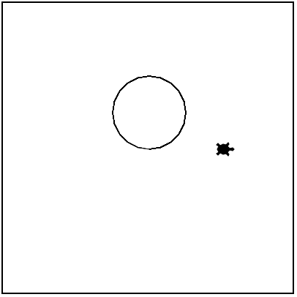
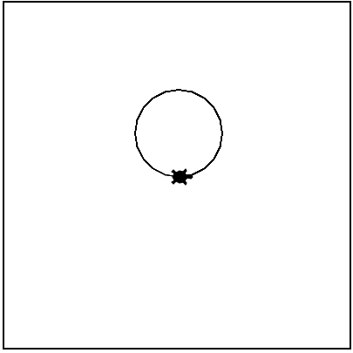
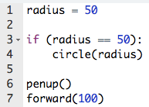
Writing an If Statement
True
Run command
Run command
Run command
Notes:
Let’s look at this sample code.
We have a variable named radius with a value of 50.
My if statement is using the condition ‘radius = 50’, which is true, (Click for green arrow) so Tracy will follow the command indented below and draw a circle.
Once this command is complete, Tracy then moves on to the next commands, (Click for green arrows) where she lifts the pen up and then moves forward 100 pixels.

Slide 9
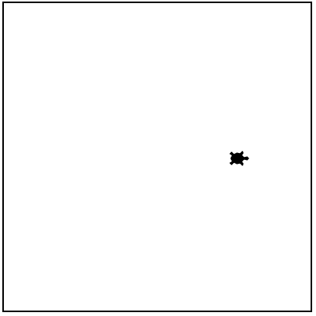
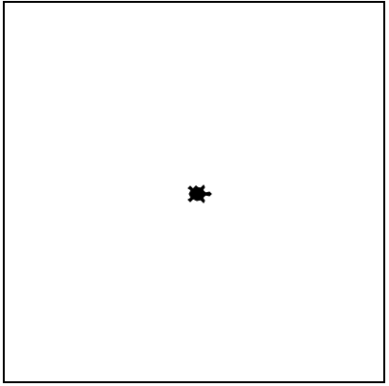
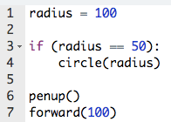
Writing an If Statement
False
skip
Run command
Run command
Notes:
We’ve now altered our code by changing the variable radius to have a value of 100.
When Tracy checks the condition now, it is false because radius is not equal to 50 (Click for red arrow) so Tracy skips the indented command and moves (Click for green arrows) to complete the commands that follow the if statement, where she lifts the penup and moves forward 100 pixels.
Let’s look at a Tracy program that uses if statements to complete a specific challenge.

Slide 10
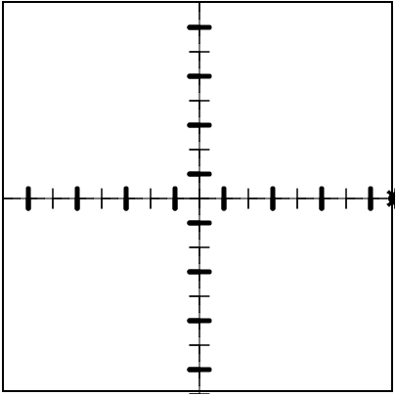
Example #1: X and Y Axis with Bolded Marks
Enhance your X and Y axis program by making every other mark bolded.
Notes:
This program is adding another upgrade to our x and y axis program by bolding every other hash mark on our axes.

Slide 11
Example #2: X and Y Axis with Bolded Marks
0
Bold marks at 0, 2, 4, 6…
2
All Even numbers!
4
6
If hash_mark % 2 == 0:
Bold
Notes:
Now, let’s think of a way we can make this happen. Well, we want every other mark to be bold, so that means (Click for label and numbers) we want mark 0, 2, 4, 6, etc. to be bold. What do these numbers have in common? (Click for label) They’re all even! We can use this to write a condition for our if-statement!
The modulus operator can help us determine if a number is even because any even number divided by 2 will have a remainder of 0! (Click for label) So our condition will be checking if a variable that counts the hash marks divided by 2 has a remainder. If the remainder is 0, it means my hash mark is even and therefore should be bolded! Let’s go to our code editor to write this program.

Slide 12
Commands Learned this Lesson
Command | What does it do?
if condition: commands | Declares an if statement with a condition. The commands indented below will be completed if condition is true
Notes:
In this lesson, we learned how to use if statements to have Tracy make decisions based on conditions. Use if statements to solve the next set of Tracy challenges!

